Slide 1

BIKE SALES ANALYSIS DASHBOARD
By
SUMITHRA D

Slide 2
OVERVIEW
Introduction & Objective
Data Preparation & Cleaning
Analysis & Metric Creation
Dashboard Design & Visualizations
Validation & Conclusion

Slide 3
INTRODUCTION
This project explores the key factors influencing customer decisions to purchase a bicycle by transforming raw demographic data into a high-impact, interactive dashboard. By analyzing variables such as income, age brackets, and commute distances, the study identifies high-potential customer profiles—such as middle-aged professionals and short-distance commuters—who are most likely to invest in a bike. The final dashboard serves as a dynamic analytical tool, allowing stakeholders to filter trends by region or education level to make informed, data-driven decisions for targeted marketing and strategic inventory planning in 2025.

Slide 4
OBJECTIVE
Perform End-to-End Data Cleaning
Analyze Consumer Demographics
Evaluate Lifestyle and Behavioral Drivers
Implement Data Segmentation
Develop an Interactive Dashboard

Slide 5
DATA SOURCE & DATA PREPARATION
This dataset was sourced from Kaggle platform and contains 1027 rows of customer data related to bike purchases. It includes demographic attributes such as age, income, marital status, education level, and occupation, as well as home ownership, commute distance, and car ownership.
The dataset provides valuable insights into consumer behavior, helping to analyze who is more likely to purchase a bike based on lifestyle, financial status, and commuting habits. This structured dataset allows for effective data visualization and business intelligence analysis to inform marketing strategies and operational decisions.
This project involved multiple steps, from data preparation and cleaning to analysis and visualization, ensuring an effective and structured approach to extracting insights. Below is the detailed process:
Data Cleaning and Data Formatting
  Created Pivot table and Built Recommended Chart based on pivot table
  Created Slicers
  Finally built interactive dashboard

Slide 6
DATA CLEANING AND TRANSFORMATION
Identified and removed duplicate records using Excel’s ‘Remove Duplicates’ feature to enhance data integrity.
Standardized categorical variables (Marital Status and Gender) using ‘Find and Replace’ (Ctrl+H) to improve readability, user-friendliness and consistency in reporting.
Income column- change the format(removing the decimal point) Reviewed and ensured consistency in the ‘Income’ column’s currency format.
Addressed potential sorting issues in the ‘Commute Distance’ column by standardizing the ‘More than 10 miles’ category which improves sorting in the pivot table.
Created a new column named “Age Brackets” to group individual ages into broader categories for more meaningful visualizations.
Next, I assigned age brackets based on the “Age” column using a nested IF statement. For example:
  If Age is less than 31, the “Age Bracket” is “adolescent”
  If Age is greater than or equal to 31 and less than or equal to 54, the “Age Bracket” is “middle age”
  If Age is greater than 54, the “Age Bracket” is “old”
  =IF(L3>54,”Old”,IF(L3>=31,”Middle Age”,IF(L3< 31, “Adolescent”,”Invalid”)))

Slide 7
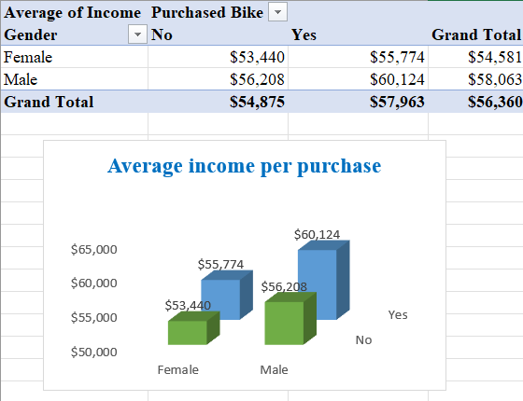
CREATE PIVOT TABLE AND RECOMMENDED CHARTS
Pivot Table 1: Average Income by Gender and Purchase Status

Slide 8
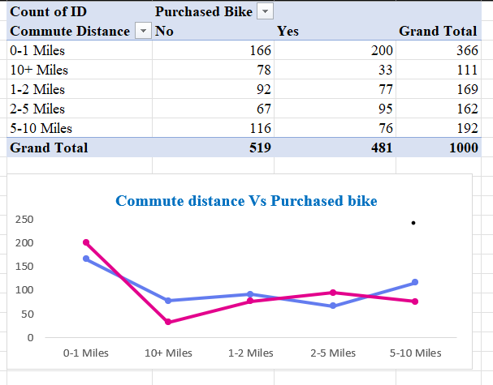
CREATE PIVOT TABLE AND RECOMMENDED CHARTS
Pivot table 2: Purchase of Bike on basis of distance

Slide 9
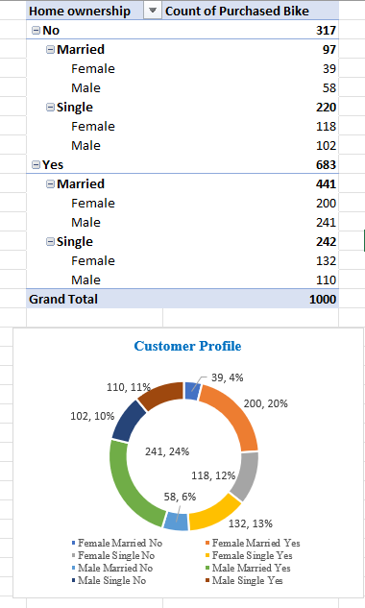
CREATE PIVOT TABLE AND RECOMMENDED CHARTS
Pivot table 3: Purchase of bike on basis of age, gender, Marrital status.

Slide 10
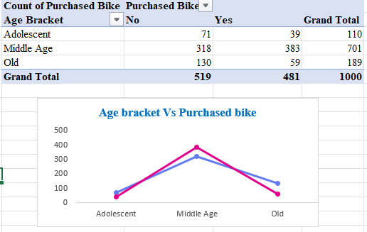
CREATE PIVOT TABLE AND RECOMMENDED CHARTS
Pivot table 4: Purchase of bike on basis of age

Slide 11
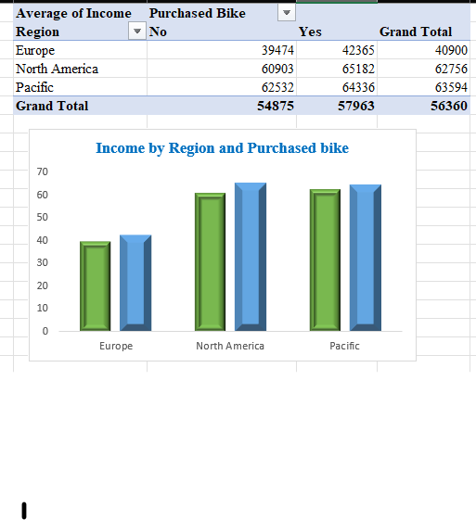
CREATE PIVOT TABLE AND RECOMMENDED CHARTS
Pivot table 5: Income by Region and Purchased bike

Slide 12
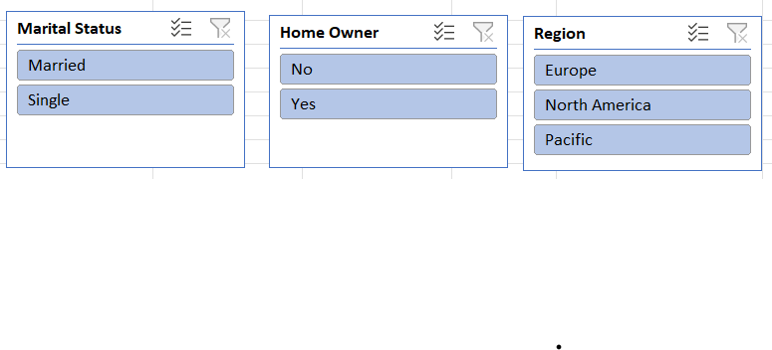
CREATE SLICER
Slicer- are visualization that allow viewers to refine the data for themselves
This project created 3 slicers i.e Marital Status, Region and Home ownership.

Slide 13
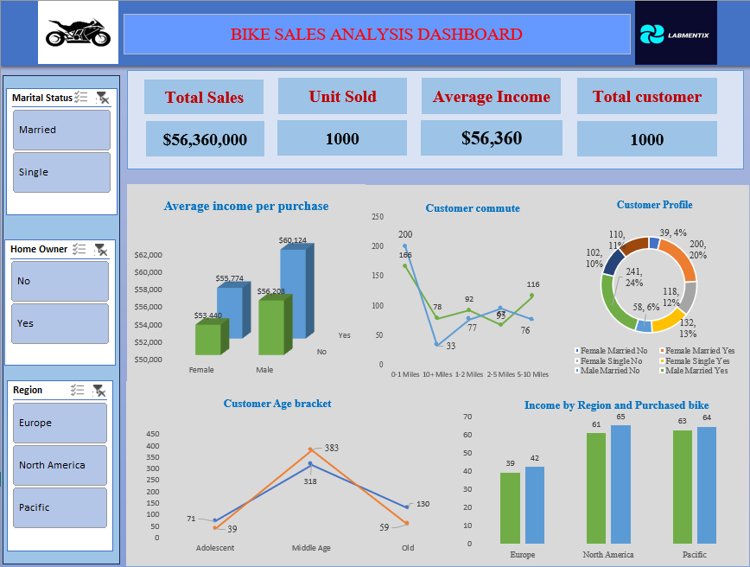
BUILD INTERACTIVE DASHBOARD

Slide 14
CONCLUSION
Data Reliability: Successfully pre-processed a dataset of 1,000 customers by removing duplicates and standardizing categorical fields (e.g., Marital Status, Gender), ensuring an accurate foundation for analysis.
Enhanced Segmentation: Used Feature Engineering (nested IF statements) to create age brackets, revealing that Middle-Aged adults (31–54) are the dominant consumer group, purchasing significantly more bikes than adolescents or seniors.
Income as a Key Driver: Data consistently shows that bike purchasers have a higher average income (e.g., ~$60,124 for males and ~$55,774 for females) compared to non-purchasers, indicating that financial capability strongly influences the decision to buy.
Commute Distance Influence: Sales peak for customers with short commutes (0–5 miles), suggesting that bikes are viewed primarily as a local transportation or fitness solution rather than a long-distance commute alternative.
Strategic Demographic Patterns: Married individuals and those with higher education levels (e.g., Graduate Degree holders) exhibited higher purchase rates, providing clear targets for tailored marketing campaigns.
Regional Market Dominance: North America emerged as the primary market for bike purchases, followed by Europe, highlighting specific geographic regions for resource allocation and expansion.
Interactive Decision Support: The creation of a dynamic dashboard with Slicers (Region, Education, Marital Status) transforms raw data into an actionable tool for stakeholders to explore specific micro-markets in real time.
Future Market Potential: Current 2025 trends indicate a rising demand for specialized products like e-bikes and hybrid models for health-conscious urban commuters, offering a clear path for future product diversification.

Slide 15


